Slide 1

Learning from history:
Arenas in Computer Science
Innovation is never looking back
History of Computing, Siegen, June 10, 2016
Volkmar Pipek,
University of Siegen

Slide 2
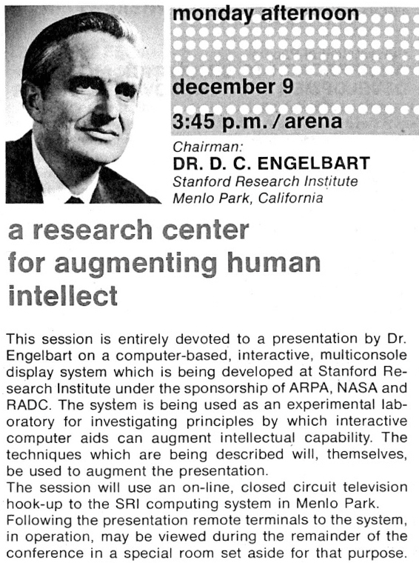
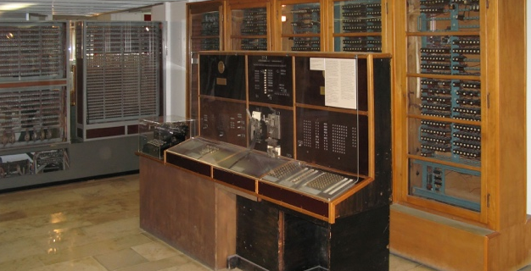
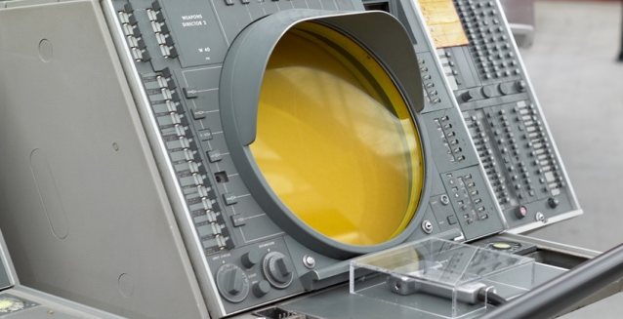
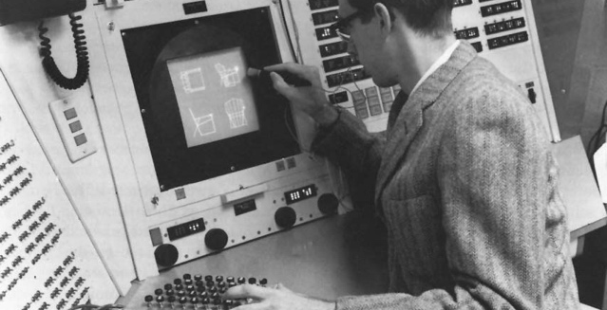
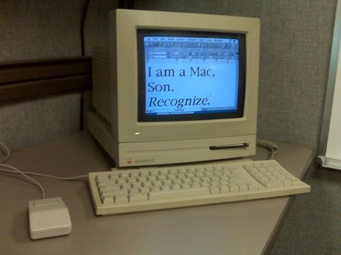
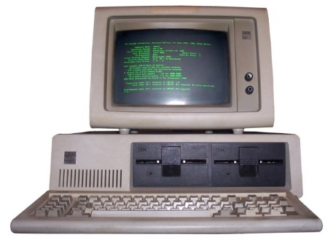
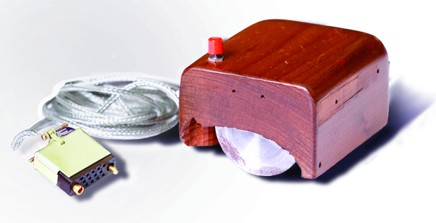
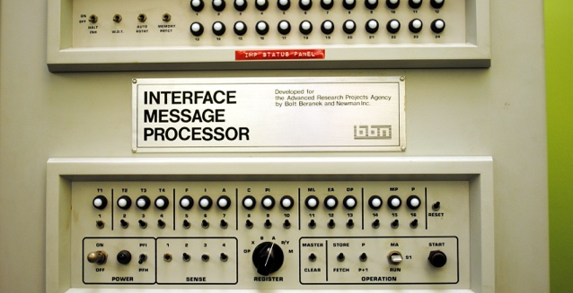
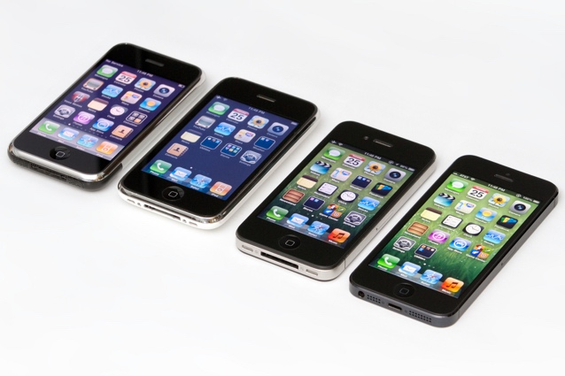
History of Computer Science: The usual narratives
How we came to be here
Abb. links: Clemens Pfeiffer – Zuse Z4 - CC BY 2.5
Abb. rechts: Joi Ito – SAGE - CC BY 2.0

Slide 3
Hidden arenas: Modeling an unanticipable world
The development of the Coordinator (1988) and Suchman’s fundamental criticism
State-transition diagram in a conversation network based on Searle (Nodes represent conversation states, edges represent speech acts)
A: Decline
Report
A:Declare
Complete
1
A:Request
2
B:Promise
3
4
5
B: Report
Completion
A: Accept
A: Counter
B: Cancel
B: Counter
6
7
B: Decline
A: Cancel
A: Cancel
B: Cancel
A: Cancel
A: Cancel
8
9
(Winograd, Flores, 1988)

Slide 4
Hidden arenas: Modeling an unanticipable world
The development of the Coordinator (1988) and Suchman’s fundamental criticism
Suchman 1994: Do categories have politics? (Discussion: JCSCW 1995)
  SAT for system design implies control over organization members’ actions.
  Willingness to re-formulate actions in technical vocabulary?!
  Contest over how our relations to each other are ordered and by whom
  Coordinator successful because of practical adaptability, not because of theory driven coherence (Studies: Users ignore parts of the system if necessary)
  Conclusive claim: Coordinator shows that it is not a tool for collaborative action, but a tool for reproduction of an established social order
Background also: Suchman 1987: Plans and Situated Action
  Establishes the perspective that plans are just patterns that are modified according to current situation before actions are performed.

Slide 5



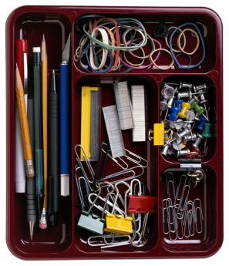

Hidden arenas: Engineering (production methods)
What is Computer Science?
„Dijkstras Firewall“
Computer Failure
TWacholder = CLASS(TTree)
PRIVATE
COLOR : Tcolor;
Height : integer;
Width : integer;...
END;
Application context and practices
Pleasantness Problem
Correctness Problem

Slide 6
Hidden arenas: Engineering (production methods)
Dijkstra on software management (pragmatism of programming) vs. software design (art of programming)
Let me give you just one example illustrating how serious the consequences of the thus engendered confusion may be. One of the planning documents for software research revealed --in a parenthetical remark only-- an unchallenged tacit assumption by referring to "the tradeoff between cost and quality". Now in all sorts of mechnical engineering it may make sense to talk about "the tradeoff between cost and quality", in software development this is absolute nonsense, because poor quality is the major contributor to the soaring costs of software development. What can you expect from a planning document that is (implicitly) based on such profound misunderstanding? (E.W. Dijkstra, in ‚The pragmatic engineer versus the scientific designer‘, November 1978, retrieved from https://www.cs.utexas.edu/users/EWD/transcriptions/EWD06xx/EWD690.html)

Slide 7
iSchool Siegen and History of computing
Q1: The iSchool Siegen has a unique constellation not only because these discipline aim to connect their research, but also by its epistemological position of grounding research in practices in analytical as well as design-oriented work. Neither in Computer Science/Information Systems nor in the Media Studies this was a mainstream position. There is already a lively dialogue between these disciplines, and part of the discourse is looking back at failures and missed opportunities.

Slide 8
History integrated into teaching and research in CS
Q2: Work on our History helps us to identify the big patters that have made successes as well as failures. CS is a discipline that had such a tremendous success in terms of economic and societal acknowledgement that it traditionally looks into the usually bright future, not into the potentially dark past. This attitude produces a tangible methodological problem that could be more visible based on Historicians work.

Slide 9
Specialists we need in the History of Technology
Q3: It requires a unique skill to produce a wholistic account of the history of computing/IT. I usually would not trust specialists that would not have a sound knowledge not only of the history of programming, but also of programming itself, including the specialized methods of project management that help inform the engineering of software (up to todays Cyber-Physical Systems). Together with a knowledge of the development of the material basis (hardware and networks) and the developing effects on economies and societies they can provide not only a wide angle, but also at a depth that would help recognizes the fundamental problem of the requirements to model (to anticipate an unanticipable world) to a level of accuracy that would allow a generalized computational service to produce a reliable result in every specific practice situation.

